Slide 1


KGiSL Institute of Technology
(Approved by AICTE, New Delhi; Affiliated to Anna University, Chennai)
Recognized by UGC, Accredited by NBA (IT)
365, KGiSL Campus, Thudiyalur Road, Saravanampatti, Coimbatore – 641035.
Department of Artificial Intelligence and
Machine Learning
Name of the Faculty : ASWINI.C
Subject Code & Name : 24UAMP10 - MLOPS
Branch & Department : B.E CSE(AI&ML)
Year & Semester : III/V
Academic Year : 2026-2027

Slide 2
VERSION CONTROL
Version Control is the process of tracking and managing changes made to files over time.
Allows developers and data scientists to record every modification, compare versions, restore previous versions, and collaborate efficiently.

Slide 3
In traditional software development, version control mainly tracks source code.
In MLOps, version control extends beyond code to include:
Source Code
Datasets
Machine Learning Models
Experiments
Configuration Files
Pipelines
Documentation

Slide 4
Why Version Control is Important in MLOps?
Version 1:
Dataset: 5,000 images
Accuracy: 88%
Version 2:
Dataset: 10,000 images
Accuracy: 92%
Version 3:
Changed CNN architecture
Accuracy: 95%

Slide 5
Without version control, it becomes difficult to know:
Which dataset produced the best model?
Which code generated the model?
What hyperparameters were used?
How to reproduce the same results?
Version control solves these problems.

Slide 6
Why Traditional Version Control is Not Enough?
Software projects mostly track code.
Machine Learning projects involve:
Large datasets (GBs or TBs)
Trained models
Feature engineering scripts
Hyperparameters
Experimental results
Git alone cannot efficiently handle large datasets and binary model files.

Slide 7
Components that Need Versioning in MLOps
Component | Why Version?
Source Code | Track code changes
Dataset | Know which data trained the model
Model | Store trained models
Hyperparameters | Reproduce experiments
Configurations | Ensure consistent training
Pipeline | Track workflow updates
Features | Maintain feature consistency
Documentation | Record project evolution

Slide 8
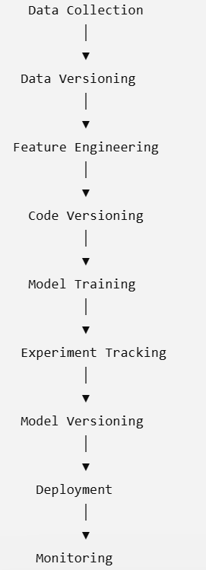
Version Control Workflow in MLOps

Slide 9
Types of Version Control
Code Versioning
Data Versioning
Model Versioning
Experiment Versioning

Slide 10
Advantages of Version Control
Tracks every change.
Supports team collaboration.
Enables rollback to previous versions.
Improves reproducibility.
Prevents accidental data loss.
Simplifies debugging.
Maintains project history.
Enhances auditability and compliance.

Slide 11
Challenges
Large datasets cannot be efficiently stored in Git.
Model files can be very large.
Storage requirements increase over time.
Multiple versions require careful management.
Teams need disciplined commit and branching practices.

Slide 12
Code versioning
Student A → train.py
Student B → preprocess.py
Student C → app.py
Real-world Analogy
Think of Google Docs.
Every edit is recorded.
See who made changes.
Restore an earlier version.
Compare versions.

Slide 13
GIT
Git is a distributed version control system
Tracks changes in source code and allows multiple developers to work together efficiently.

Slide 14
Git tracks
.py
.ipynb
.txt
.md
.json
.yaml
Dockerfile
requirements.txt

Slide 15
Git does not efficiently track:
Large datasets
Trained models
Videos
These are handled by tools like DVC.

Slide 16
Centralized vs Distributed Version Control
Centralized
Developer
\
Developer ---- Server
/
Developer
If the server fails, everyone is affected.

Slide 17
Distributed (Git)
Developer A ← Complete Copy
Developer B ← Complete Copy
Developer C ← Complete Copy
GitHub ← Another Copy

Slide 18
Git Architecture
Working Directory
│
git add
│
▼
Staging Area
│
git commit
│
▼
Local Repository
│
git push
│
▼
Remote Repository (GitHub)

Slide 19
Working Directory: where you edit files.
Staging Area: select changes to include.
Local Repository: save a snapshot with a commit.
Remote Repository: share with others.

Slide 20
GIT Installation
https://git-scm.com/downloads
Choose the version for their operating system (Windows/macOS/Linux).

Slide 21
GIT Commands
Command | Purpose
git init | Initialize repository
git clone | Copy repository
git status | View changes
git add | Stage files
git commit | Save changes
git log | View commit history
git branch | Create branch
git checkout | Switch branch
git merge | Merge branches
git pull | Fetch latest updates
git push | Upload changes

Slide 22
Data Versioning
Git is used for code
DVC (Data Version Control) are used to version datasets and models
Git is not designed to store large binary files efficiently.

Slide 23
Data Versioning is the process of tracking, managing, and storing different versions of datasets so every ML experiment can be reproduced.
Restore old datasets.
Compare dataset versions.
Know exactly which dataset trained each model.
Collaborate without overwriting data.

Slide 24
Git does not work efficiently for:
5 GB datasets
Images
Videos
Audio
Trained models

Slide 25
DVC
DVC (Data Version Control) is an open-source tool that extends Git to
manage datasets and machine learning models.
Git stores:
Code
Configuration
DVC metadata files
DVC stores:
Large datasets
Trained models
This combination gives you full reproducibility.

Slide 26
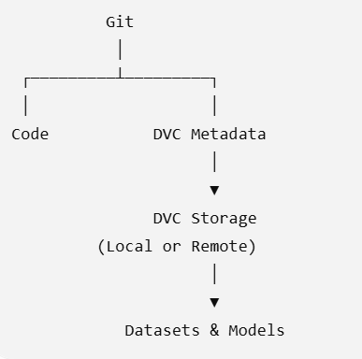
Architecture

Slide 27
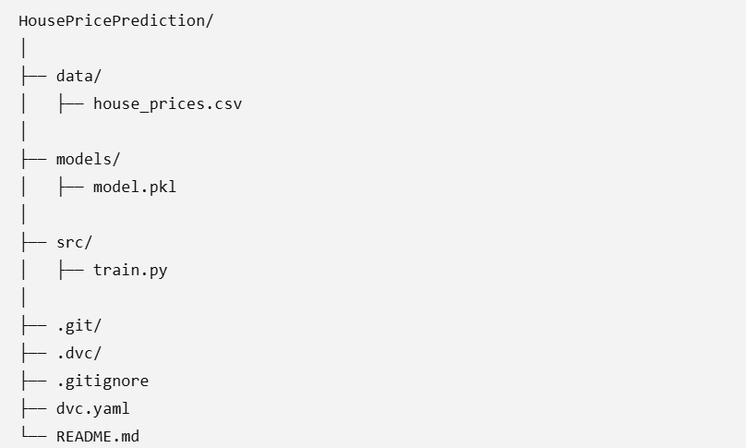

Slide 28
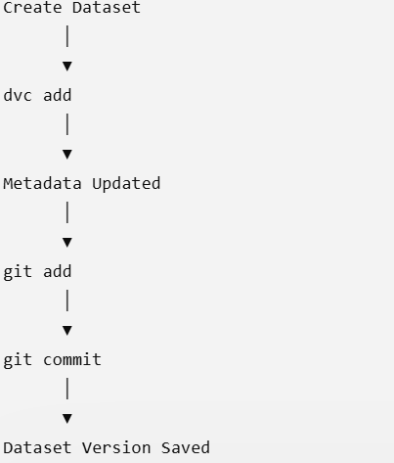
Data Versioning Workflow

Slide 29
DVC Installation
pip install dvc
dvc --version

Slide 30
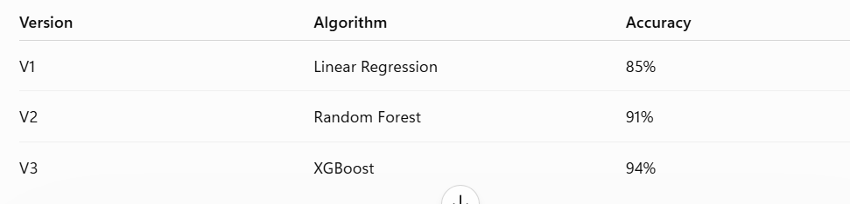
Model Versioning
If V3 fails in production, you may need to deploy V2 again. Without versioning, that rollback is difficult.

Slide 31
Model Versioning is the process of storing, tracking, and managing trained models along with the information needed to reproduce them.
Model file
Training dataset version
Hyperparameters
Performance metrics
Training code version

Slide 32
What Should Be Tracked?
For each model version, record:
Model file (model.pkl, model.h5, etc.)
Dataset version
Feature engineering version
Hyperparameters
Metrics (Accuracy, Precision, Recall, F1, RMSE, etc.)
Training date
Git commit ID

Slide 33
Environment and Dependency Management
Machine Learning projects depend on many software components
Python
NumPy
Pandas
Scikit-learn
TensorFlow
PyTorch
Matplotlib
OpenCV
XGBoost

Slide 34
Different projects often require different versions of these libraries.
If these versions are not managed properly, applications may stop working or produce inconsistent results.
Example:
Image classification model
Person:1
Python 3.10
TensorFlow 2.15
NumPy 1.26
OpenCV 4.8

Slide 35
Person 2:
Python 3.13
TensorFlow not installed
NumPy 2.0
When they run the project, they encounter errors such as:
Module not found error
Attribute error
Import error
The same code behaves differently because the software environment is different.

Slide 36
Environment
An environment is the collection of software required to execute a project.
Operating System
Python version
Installed libraries
Package versions
Environment variables
Configuration files

Slide 37
Environment
Operating System : Windows 11
Python : 3.10.11
NumPy : 1.26.4
Pandas : 2.2.0
Scikit-learn : 1.4.2
TensorFlow : 2.15.0

Slide 38
Dependency Management
A dependency is any external software package that your project needs.
Example:
import pandas
import numpy
import sklearn
These packages are dependencies.

Slide 39
Dependency management:
Installing required libraries
Tracking library versions
Updating libraries safely
Sharing dependency information
Recreating the same environment on another computer

Slide 40
Environment Management | Dependency Management
Creates isolated workspaces | Manages project libraries
Controls Python version | Controls package versions
Prevents conflicts | Ensures correct libraries are installed
Example: venv, Conda | Example: pip

Slide 41
Virtual Environment
A Virtual Environment is an isolated Python workspace that contains its own:
Python interpreter
Installed libraries
Package versions
Configuration
Each project has its own independent environment.
Changes made inside one virtual environment do not affect other
projects or the system-wide Python installation.

Slide 42
Project : 1
A facial recognition system
Required software:
Python 3.10
TensorFlow 2.15
NumPy 1.26
OpenCV 4.8

Slide 43
Project 2:
A new chatbot application.
Required software:
Python 3.13
TensorFlow 2.20
NumPy 2.0

Slide 44
Project B
TensorFlow 2.15
↓
Upgrade TensorFlow
↓
TensorFlow 2.20
↓
Project A stops working

Slide 45
Use of Virtual Environment:
Avoid Dependency Conflicts
Project Isolation
Easy Collaboration
Reproducibility
Easy Deployment
Better Project Management

Slide 46
Disadvantages:
Additional disk space.
Separate package installation for each project.
Must activate the environment before running the project.
Beginners sometimes forget which environment is active.

Slide 47
Basics of Docker and MLOps Pipeline
A data scientist develops a Machine Learning model on their laptop.
Python 3.10
TensorFlow 2.15
NumPy 1.26
OpenCV 4.8
The developer sends the project to another engineer.
Errors:
ModuleNotFoundError
TensorFlow version mismatch
OpenCV ImportError
NumPy incompatible version

Slide 48
Docker
Docker is an open-source platform used to develop, package, distribute, and run applications inside lightweight containers.
Docker packages
Application code
Python
Libraries
Dependencies
Configuration files
into a single portable unit called a container.

Slide 49
Containerization
Containerization is the process of packaging an application
together with all its dependencies into a single container.
The container can run on any system with Docker installed.

Slide 50
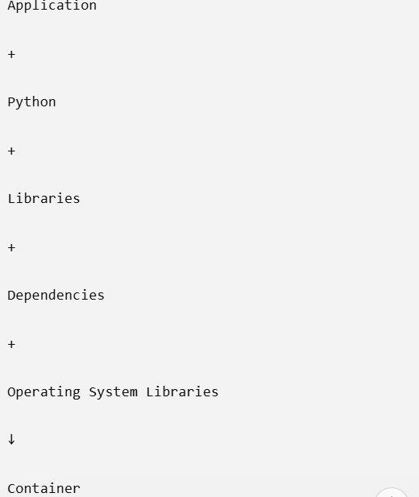

Slide 51
Features of Docker
Lightweight
Portable
Fast deployment
Platform independent
Easy scalability
Resource efficient
Isolated environment
Consistent execution

